Slide 1

HAMILTON MICROLAB® STAR
Firmware Commands

Slide 2
Firmware Commands
Vector allows you to use firmware commands to run the STAR at a low level.
Why would you do this?
If the current command set doesn’t offer a particular function.
If you need to change a particular parameter.
If you need to retrieve information from the STAR.

Slide 3
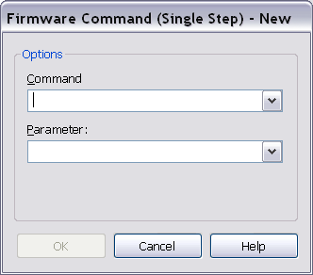
Firmware Command Dialog Box
Bring in the Firmware Command using the Configuration Editor. The Firmware command dialog box looks like this:

Slide 4
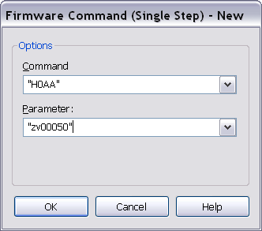
Formats
Commands and Parameters must be in quotations.
Commands are all capitals; Parameters, lower-case.

Slide 5
Warnings
Firmware commands should only be used by programmers having a very good knowledge of the firmware commands and their parameters.
The firmware command has no internal error handling implemented, i.e. this step always returns “OK.”
It is the programmer’s responsibility to interpret and check the return strings (in the trace) for errors.
Damage done to the robot as a result of sending firmware commands not provided by a Hamilton representative for a specific purpose may not be covered under warranty.

Slide 6
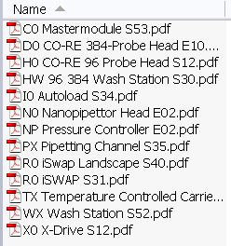
Firmware Reference Guides
Firmware Reference Guides are documents that describe the commands, parameters, and error codes.

Slide 7
Module Names
Firmware modules (please note that those are zeros!):
C0 – Master
H0 – 96 head
I0 – Autoload
PX – Pipettes
R0 – iSWAP
X0 – X-drive
WX – Wash station

Slide 8
Command Availability
Not all firmware commands and parameters will work with all versions of software and hardware.
If a firmware command does not seem to work, it could be:
Hardware is not compatible
Software is not compatible
Firmware command is subsequently overwritten by another method command and therefore not implemented during run time.
Command or parameter were incorrectly entered into the command dialog box

Slide 9
Troubleshooting
To troubleshoot a firmware command, use bind return values and use a User Output to view the returned value.
If you get er00, the command was successful.
If you get a different output, then refer to the Error Messages section of the applicable firmware reference guide.

